Slide 1
Java
More Details

Slide 2
Array

Slide 3
Arrays
A group of variables containing values that all have the same type
Arrays are fixed‐length entities
In Java, arrays are objects, so they are considered reference types
But the elements of an array can be either primitive types or reference types

Slide 4
Arrays
We access the element of an array using the following syntax
name[index]
“index” must be a nonnegative integer
“index” can be int/byte/short/char but not long
In Java, every array knows its own length
The length information is maintained in a public final int member variable called length

Slide 5
Declaring and Creating Arrays
int c[ ] = new int [12]
Here, “c” is a reference to an integer array
“c” is now pointing to an array object holding 12 integers
Like other objects arrays are created using “new” and are created in the heap
“int c[ ]” represents both the data type and the variable name. Placing number here is a syntax error
int c[12]; // compiler error

Slide 6
Declaring and Creating Arrays
int[ ] c = new int [12]
Here, the data type is more evident i.e. “int[ ]”
But does the same work as
int c[ ] = new int [12]
Is there any difference between the above two approaches?

Slide 7
Declaring and Creating Arrays
int c[ ], x
Here, ‘c’ is a reference to an integer array
‘x’ is just a normal integer variable
int[ ] c, x;
Here, ‘c’ is a reference to an integer array (same as before)
But, now ‘x’ is also a reference to an integer array

Slide 8
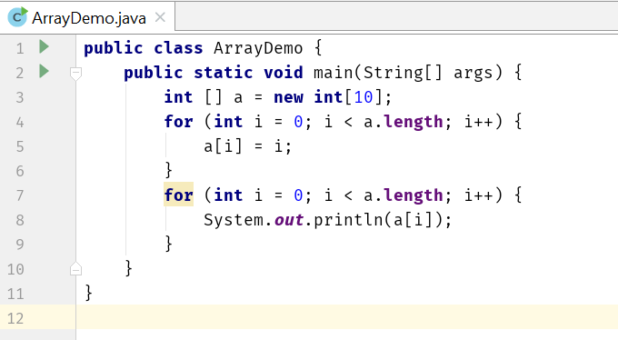
Arrays

Slide 9
Using an Array Initializer
We can also use an array initializer to create an array
int n[ ] = {10, 20, 30, 40, 50}
The length of the above array is 5
n[0] is initialized to 10, n[1] is initialized to 20, and so on
The compiler automatically performs a “new” operation taking the count information from the list and initializes the elements properly

Slide 10
Arrays of Primitive Types
When created by “new”, all the elements are initialized with default values
byte, short, char, int, long, float and double are initialized to zero
boolean is initialized to false
This happens for both member arrays and local arrays

Slide 11
Arrays of Reference Types
String [] str = new String[3]
Only 3 String references are created
Those references are initialized to null by default
Need to explicitly create and assign actual String objects in the above three positions.
str[0] = new String(“Hello”);
str[1] = “World”;
str[2] = “I” + “ Like” + “ Java”;

Slide 12
Arrays of Reference Types
class A {
private int a;
public int getA() {
return a;
}
public void setA(int a) {
this.a = a;
}
}
public class ArrayDemo2 {
public static void main(String[] args) {
A[] array = new A[10];
for (int i = 0; i < array.length; i++) {
array[i] = new A();
array[i].setA(i);
}
for (int i = 0; i < array.length; i++) {
System.out.println("Object of A: " + array[i].getA());
}
}
}

Slide 13
Passing Arrays to Methods
void modifyArray(double d[ ]) {…}
double [] temperature = new double[24];
modifyArray(temperature);
Changes made to the elements of ‘d’ inside “modifyArray” is visible and reflected in the “temperature” array
But inside “modifyArray” if we create a new array and assign it to ‘d’ then ‘d’ will point to the newly created array and changing its elements will have no effect on “temperature”

Slide 14
Passing Arrays to Methods
Changing the elements is visible, but changing the array reference itself is not visible
void modifyArray(double d[ ]) {
d[0] = 1.1; // visible to the caller
}
void modifyArray(double d[ ]) {
d = new double [10];
d[0] = 1.1; // not visible to the caller
}

Slide 15
Multidimensional Arrays
Can be termed as array of arrays.
int b[ ][ ] = new int[3][4];
Length of first dimension = 3
b.length equals 3
Length of second dimension = 4
b[0].length equals 4
int[ ][ ] b = new int[3][4];
Here, the data type is more evident i.e. “int[ ][ ]”

Slide 16
Multidimensional Arrays
int b[ ][ ] = { { 1, 2, 3 }, { 4, 5, 6 } };
b.length equals 2
b[0].length and b[1].length equals 3
All these examples represent rectangular two dimensional arrays where every row has same number of columns
Java also supports jagged array where rows can have different number of columns

Slide 17


Multidimensional Arrays
Example –1
int b[ ][ ];
b = new int[2][ ];
b[0] = new int[2];
b[1] = new int[3];
b[0][2] = 7; //will throw an exception
Example –2
int b[ ][ ] = { { 1, 2 }, { 3, 4, 5 } };
b[0][2] = 8; //will throw an exception
In both cases
b.length equals 2
b[0].length equals 2
b[1].length equals 3
Array ‘b’
Col 0
Col 1
Col 2
Row 0
Row 1
b[0][2] does not exist

Slide 18
Command Line Arguments

Slide 19
Using Command‐Line Arguments
java MyClass arg1 arg2 … argN
words after the class name are treated as command‐line arguments by Java
Java creates a separate String object containing each command‐line argument, places them in a String array and supplies that array to main
That’s why we have to have a String array parameter (String args[ ]) in main
We do not need a “argc” type parameter (for parameter counting) as we can easily use “args.length” to determine the number of parameters supplied.

Slide 20
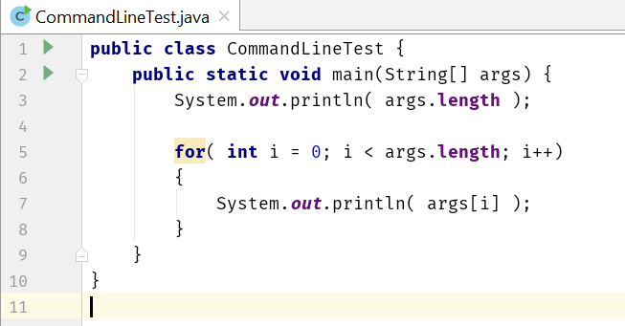
Using Command‐Line Arguments
3
Hello
2
You
java CommandLineTest Hello 2 You

Slide 21
For-Each

Slide 22
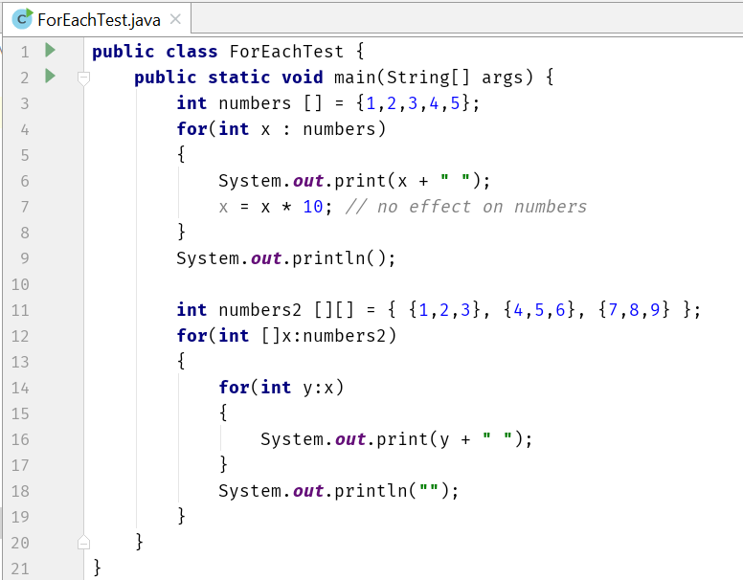
For‐Each version of the for loop

Slide 23
Scanner

Slide 24
Scanner
It is one of the utility class located in the java.util package
Using Scanner class, we can take inputs from the keyboard
Provides methods for scanning
int
float
double
line etc.

Slide 25
Scanner

Slide 26
JOptionPane

Slide 27
Static

Slide 28
Static Variables
When a member (both methods and variables) is declared static, it can be accessed before any objects of its class are created, and without reference to any object
Static variable
Instance variables declared as static are like global variables
When objects of its class are declared, no copy of a static variable is made

Slide 29
Static Methods & Blocks
Static method
They can only call other static methods
They must only access static data
They cannot refer to this or super in any way
Static block
Initialize static variables.
Get executed exactly once, when the class is first loaded

Slide 30
Static

Slide 31
Final
Declare a final variable, prevents its contents from being modified
final variable must initialize when it is declared
It is common coding convention to choose all uppercase identifiers for final variables
final int FILE_NEW = 1;
final int FILE_OPEN = 2;
final int FILE_SAVE = 3;
final int FILE_SAVEAS = 4;
final int FILE_QUIT = 5;

Slide 32
Unsigned right shift operator
The >> operator automatically fills the high‐order bit with its previous contents each time a shift occurs
This preserves the sign of the value
But if you want to shift something that doesn’t represent a numeric value, you may not want the sign extension
Java’s >>> shifts zeros into the high‐order bit
int a= ‐1; | a = a >>>24;
11111111 | 11111111 | 11111111 | 11111111 | [‐1]
00000000 | 00000000 | 00000000 | 11111111 | [255]

Slide 33
Nested and Inner Classes

Slide 34
Nested Classes
It is possible to define a class within another classes, such classes are known as nested classes
The scope of nested class is bounded by the scope of its enclosing class. That means if class B is defined within class A, then B doesn’t exists without A
The nested class has access to the members (including private!) of the class in which it is nested
The enclosing class doesn’t have access to the members of the nested class

Slide 35
Static Nested Classes
Two types of nested classes.
Static
Non‐Static
A static nested class is one which has the static modifier applied. Because it is static, it must access the members of its enclosing class through an object
That is, it cannot refer to members of its enclosing class directly. Because of this restriction, static nested classes are seldom used

Slide 36
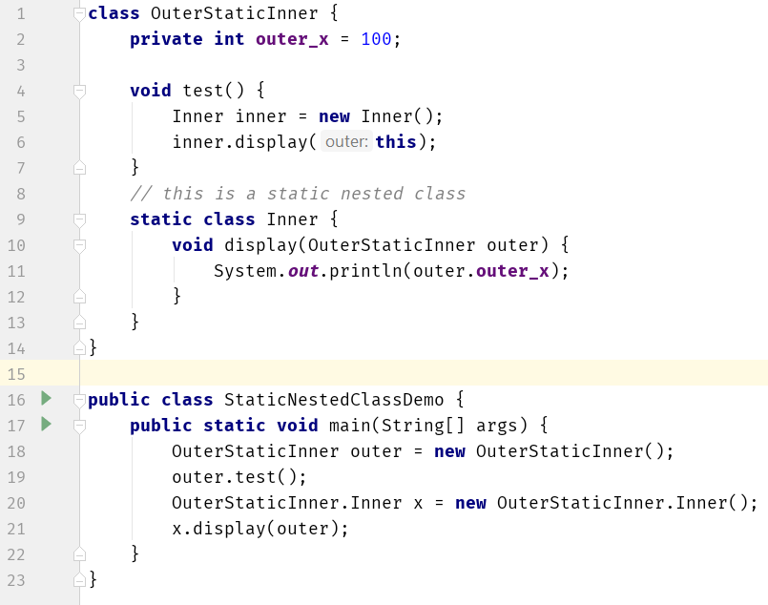
Static Nested Classes

Slide 37
Static Nested Classes
class OuterStaticInner2 { private int outer_x = 100;
static int static_x = 200; // this is a static nested class
static class Inner {
int inner_x = 100; void print() {
// System.out.println(outer_x);
System.out.println(static_x);
System.out.println(inner_x);
}
}
}
public class StaticNestedClassDemo2 {
public static void main(String[] args) {
OuterStaticInner2.Inner x = new OuterStaticInner2.Inner();
x.print();
}
}

Slide 38
Inner Classes
The most important type of nested class is the inner class
An inner class is a non‐static nested class
It has access to all of the variables and methods of its outer class and may refer to them directly in the same way that other non‐static members of the outer class do
Thus, an inner class is fully within the scope of its enclosing class

Slide 39
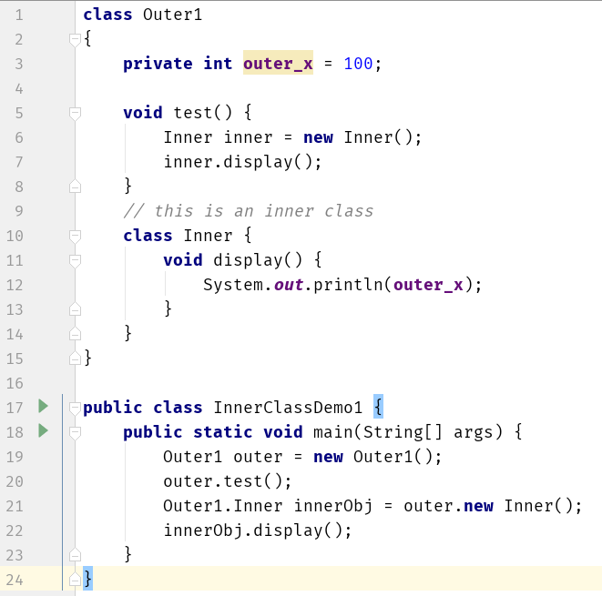
Inner Classes

Slide 40
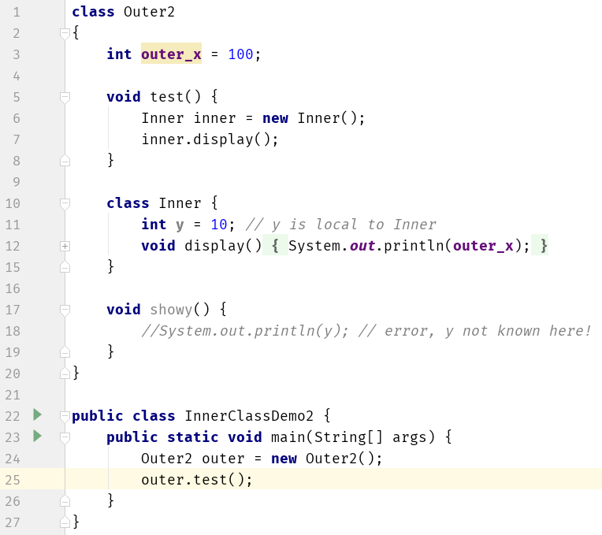
Inner Classes

Slide 41
Inner Classes
class Outer3 {
int outer_x = 100; void test() {
for (int i = 0; i < 5; i++) {
class Inner {
void display() {
System.out.println(outer_x);
}
}
Inner inner = new Inner();
inner.display();
}
}
}
public class InnerClassDemo3 {
public static void main(String[] args) {
Outer3 outer = new Outer3();
outer.test();
}
}

Slide 42
Inner Classes
class X {
int a = 10; void print() {
System.out.println("X");
System.out.println(a);
}
class Y {
int a = 20; void print() {
System.out.println("Y");
System.out.println(a);
System.out.println(X.this.a);
}
class Z {
int a = 30; void print() {
System.out.println("Z");
System.out.println(a);
System.out.println(Y.this.a);
System.out.println(X.this.a);
}
}
}
}
public class InnerClassDemo4 {
public static void
main(String[] args) {
X x = new X();
x.print();
X.Y y = x.new Y();
y.print();
X.Y.Z z = y.new Z();
z.print();
}
}

Slide 43
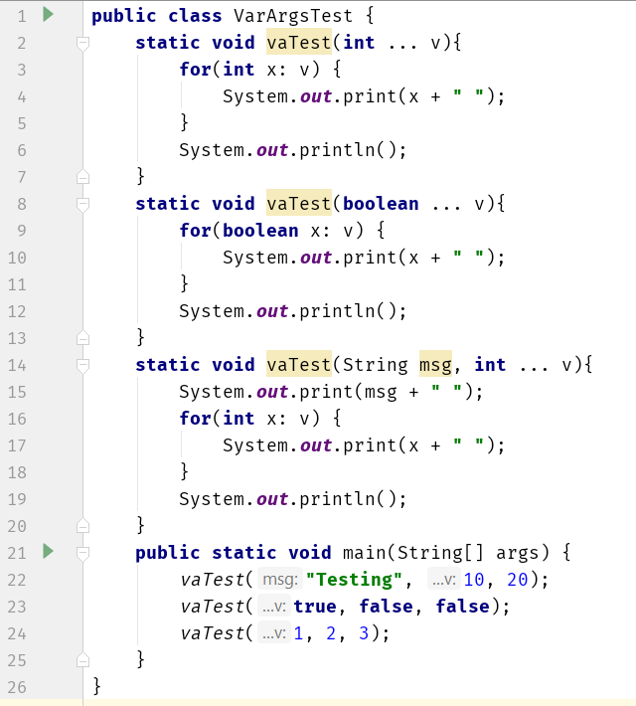
Variable Arguments

Slide 44
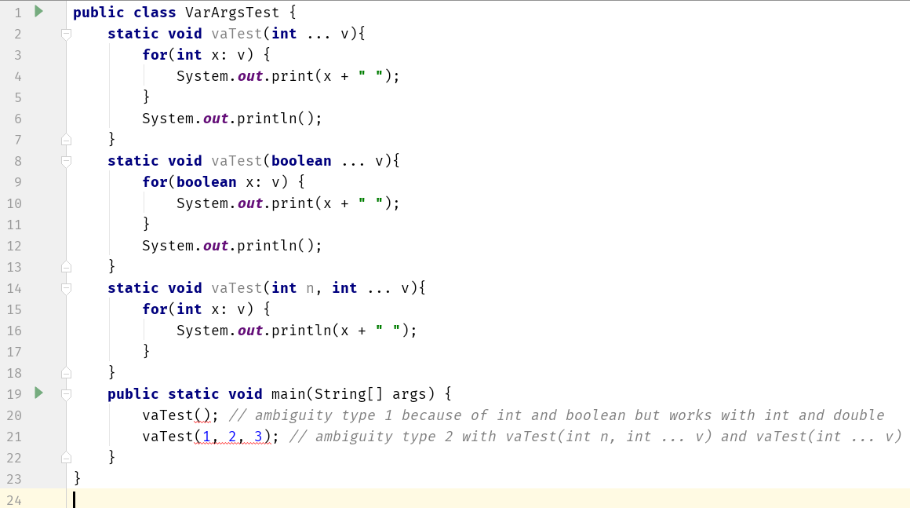
Variable Arguments Ambiguity

Slide 45
Local Variable Type Inference

Slide 46
Local Variable Type Inference
Recently added to the Java language (Java 10)
all variables must be declared prior to their use
a variable can be initialized with a value when it is declared
when a variable is initialized, the type of the initializer must be the same as the declared type of the variable
In principle, it would not be necessary to specify an explicit type for an initialized variable
it could be inferred by the type of its initializer

Slide 47
Local Variable Type Inference
Compiler infer the type of a local variable based on the type of its initializer without explicit specification
Advantages:
Streamline code by eliminating the need to redundantly specify a variable’s type when it can be inferred
Simplify declarations when the type name is quite lengthy, such as can be the case with some class names
Helpful when a type is difficult to determine
Its inclusion helps keep Java up-to-date with evolving trends in language design

Slide 48
Local Variable Type Inference
The context-sensitive identifier var was added to Java as a reserved type name
To use local variable type inference, the variable must be declared with var as the type name and it must include an initializer
double avg = 10.0; // type is explicitly specified
var avg = 10.0; // type is inferred as double because initializer (10.0) is of type double
var can still be used as user-defined identifier
int var = 1; // valid

Slide 49
Local Variable Type Inference
var cannot be used as the name of a class
var can be used to declare an array type, but cannot be used with an array initializer
var myArray = new int[10]; // valid
var myArray = { 1, 2, 3 }; // invalid
var is not allowed as an element type of an array
var[] myArray = new int[10]; // invalid
var myArray[] = new int[10]; // invalid

Slide 50
Local Variable Type Inference
var can be used to declare a variable only when that variable is initialized
var counter; // invalid
var cannot be used to declare a variable with null as the initializer
var can be used only to declare local variables, it cannot be used when declaring instance variables, parameters, or return types
var can be used in a for/for-each loop when declaring and initializing the loop control/iteration variable

Slide 51
Local Variable Type Inference
public class VarDemo {
public static void main(String[] args) {
var avg = 10.0;
System.out.println(avg);
int var = 1;
System.out.println(var);
var x = -var;
System.out.println(x);
// var y; // error
// var z = null; // error
var a = new int[10];
for(int i : a) {
System.out.print(i);
}
System.out.println();
for(var i : a) {
System.out.print(i);
}
System.out.println();
for(var k = 1; k < 10; k++) {
System.out.print(k);
}
System.out.println();
//var [] b = new int[10]; // error
//var b[] = new int[10]; // error
// var b = {1, 2, 3}; // error
}
}

Slide 52
Local Variable Type Inference
Local variable type inference can also be used with reference types
var str = “This is a string”;
Type inference is primarily used with reference types
Local variable type inference is especially effective in shortening declarations that involve long class names
Local variable type inference can also be used with user-defined classes
var mc = new MyClass();

Slide 53
Local Variable Type Inference
class MyClass{
private int x;
MyClass() {
this.x = 0;
}
void setX(int x) {
this.x = x;
}
int getX() {
return x;
}
}
public class RefVarDemo {
public static void main(String[] args) {
var mc = new MyClass();
System.out.println(mc.getX());
mc.setX(10);
System.out.println(mc.getX());
var str = "Hello World";
System.out.println(str);
}
}

